Slide 1
Entity Matching Tools Comparison
CAS 771 – Big Data Systems & Applications Final Project
Baran Kaya

Slide 2

Outline
Introduction
Entity Matching
Project Summary
Tools/Systems
Methods
Outcome
References

Slide 3
Introduction
Project:
Performance and features comparison of researched based entity matching algorithm tools VS the commercial tools
Next:
What is Entity Matching?

Slide 4
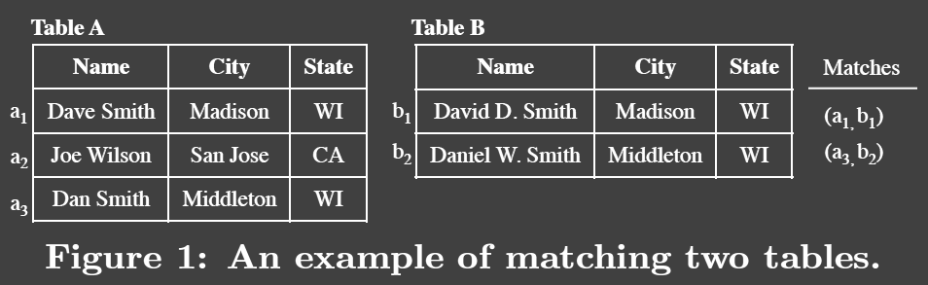
Entity Matching
One of the biggest challenges in the data management
“Entity matching (EM) identifies data instances that refer
to the same real-world entity.”

Slide 5

Entity Matching names
Record Linkage
Deduplication
Entity Resolution
Data Matching
Merge-Purge
Object Identification
Identity Uncertainty
Entity Clustering
Duplicate Detection
Reference Matching
Fuzzy Match
Approximate Match

Slide 6
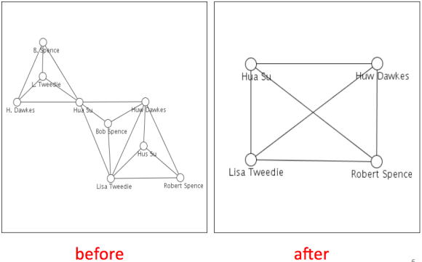
Entity Matching
Different storing formats
Names
Emails
Dates
Different photos of the same object
Missing Values (NULL, NA, Unknown)
Errors in data (Misspelling)
Image from: Entity Resolution: Tutorial [4]

Slide 7
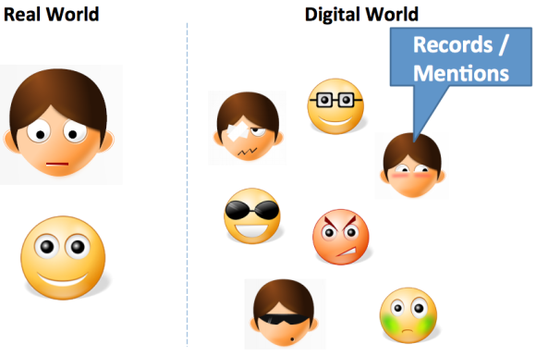
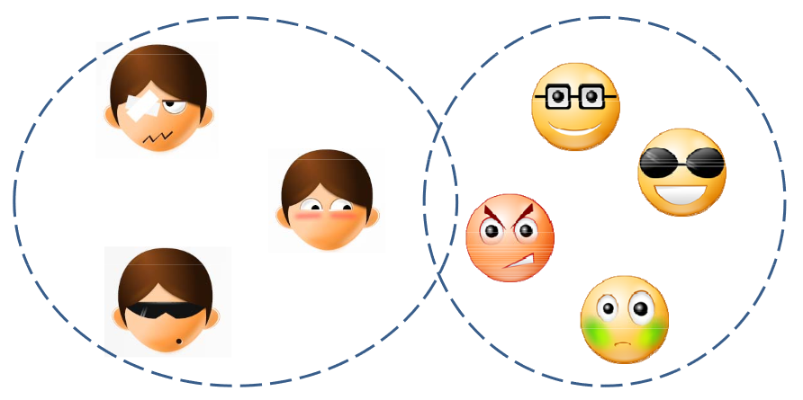

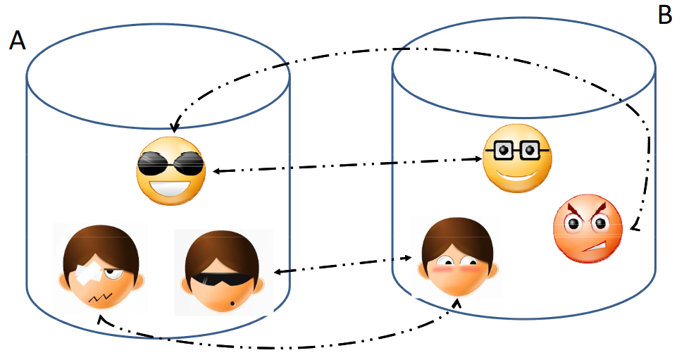
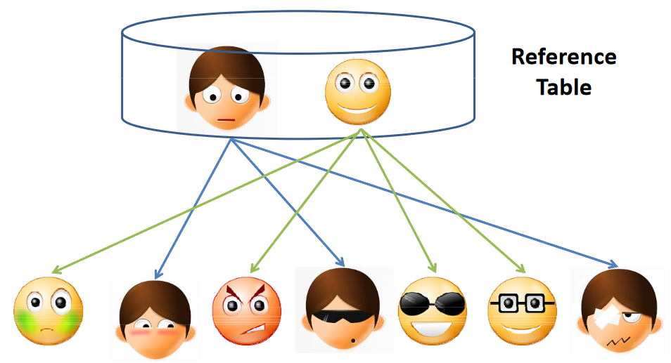
Entity Matching
Images from: Entity Resolution: Tutorial [4]
Notes:
Deduplication
Record Linkage
Reference Matching

Slide 8
Big-Data Entity Matching [4]
Large dataset (Efficient solution)
Heterogeneous
Unstructured, unclean, incomplete data & diverse data types
More linked
Multi-Relational
Multi-Domain
Multiple applications
Notes:
Big‐Data ER Challenges
•Larger and more Datasets – Need efficient parallel techniques
•More Heterogeneity – Unstructured, Unclean and Incomplete data. Diverse data types.
•More linked – Need to infer relationships in addition to “equality”
•Multi‐Relational – Deal with structure of entities (Are Walmart and Walmart Pharmacy the same ?)
•Multi‐domain – Customizable methods that span across domains
•Multiple applications (web search versus comparison shopping) – Serve diverse application with different accuracy requirements

Slide 9
Project Summary
Goal: Compare academic and real-world ready systems
6-8 different systems
Found 10 different systems that consist of:
Research based open source systems
Commercial systems
Commercial systems are not free
Free trial versions
IBM InfoSphere
10 tools → Find the best ones for the project

Slide 10
EM Tools/Systems
Research Based Tools
Commercial Tools
Magellan [1]
Dedupe
SERF (Stanford Entity Matching Framework) [2]
Python Record Linkage Tool
Febrl (Freely Extensible Biomedical Record Linkage)
FRIL
DataLadder
SAS DataFlux
WinPure
Management Ware – Deduplication Tool

Slide 11
Project Methods
All of the systems are going to be tested with the same data in the same situation.
Find entity matching test data
Prepare scenarios
Research based tools experiment
Experiment
Reading algorithms’ paper
Commercial tools
Data management experience form the previous experiments
Prepare a final report with experiment results

Slide 12
Project Schedule
Tasks | Dates
Getting data & preparing it | February 10-16, 2020
Getting all the systems | February 17-24, 2020
Research based system experiments | February 24 - March 15, 2020
Commercial system experiments | March 16 – March 29, 2020
Preparing the final report | March 30 – April, 2020

Slide 13
Project Outcome
Experiment: Same scenario & Same data
Compare experiment results for
Performance (computation time)
Result accuracy
Features (criteria)
Find main focus of each system
Initial predictions:
Commercial systems focus → Performance
Researched based systems focus → Accuracy

Slide 14
References
THANK YOU!
[1] Konda, Pradap, et al. "Magellan: Toward building entity matching management systems." Proceedings of the VLDB Endowment 9.12 (2016): 1197-1208.
[2] Benjelloun, Omar, et al. "Swoosh: a generic approach to entity resolution." The VLDB Journal 18.1 (2009): 255-276.
[3] Bohannon, Philip, et al. "A cost-based model and effective heuristic for repairing constraints by value modification." Proceedings of the 2005 ACM SIGMOD international conference on Management of data. 2005.
[4] Getoor, Lise, et al. “Entity Resolution: Tutorial”, Online: http://users.umiacs.umd.edu/~getoor/Tutorials/ER_VLDB2012.pdf
DataLadder: https://dataladder.com/data-deduplication-software/
SAS DataFlux: http://support.sas.com/software/products/dfdmstudioserver/index.html#s1=1
WinPure: https://winpure.com/deduplication-software.html#freedemo
Management Ware – Deduplication Tool: https://datacleansingmatching.com/data-cleansing-data-matching-software-download/
Magellan: https://sites.google.com/site/anhaidgroup/projects/magellan
Dedupe: https://github.com/dedupeio/dedupe
SERF (Stanford Entity Matching Framework): http://infolab.stanford.edu/serf/
Python Record Linkage Tool: https://recordlinkage.readthedocs.io/en/latest/about.html
Febrl: https://sourceforge.net/projects/febrl/
FRIL: http://fril.sourceforge.net/
Outline Image: Photo by Skye Studios on Unsplash
Notes:
https://www.youtube.com/watch?v=MPHd1eqU_yo
https://www.youtube.com/watch?v=DXGG5m7qHdE

